Slide 1
Pitch Deck
Enterprises Business Management System
Presented By : CYBERNETIC CITADEL
Name of Team Member - 1 – Jyotiraditya Roy
Name of Team Member- 2 – Aryaksh Bhatnagar
Name of Team Member - 3 – Lakshya Garg
Name of Team Member - 4 – Pranjal Khandelwal

Slide 2
Problem Statement
Problem of small and medium enterprises to engage collaboration, communication, collaboration, and collective decision making among residents, local Organizations and authorities using blockchain with centralized or decentralized system and also provide a virtual ai assistant for a specific use case like use other platform on same platform.

Slide 3



Solution :
Creating a community engagement system application for small and medium enterprises (SMEs) that fosters collaboration, communication, and collective decision-making among residents, local organizations, and authorities, along with an integrated virtual AI assistant, involves several key components.
C-PRIHUB

Slide 4
01
02
03
Communication Channels
Messaging: Private and group messaging systems.
Announcements: Area for local authorities and organizations to post important updates.
Notifications: Real-time notifications for new messages, announcements, and project updates.
Collective Decision-Making
Polls and Surveys: Tools for gathering community feedback on various issues.
Voting System: Secure voting mechanism for community decisions.
Suggestion Box: Area for residents to submit ideas and suggestions.
User Registration and Authentication
Secure user registration and login system.
Role-based access control for residents, local organizations, and authorities.

Slide 5
04
05
06
Virtual AI Assistant
Chatbot Integration: AI assistant that can answer FAQs, provide information, and assist with navigation within the app.
Task Automation: Automate repetitive tasks like scheduling meetings or sending reminders.
Data Analysis: Analyze community engagement data to provide insights and recommendations.
Cross-Platform Integration
Integration with other platforms (e.g., social media, email) to ensure seamless communication and engagement.
Data Security and Privacy
Ensure compliance with data protection regulations.
Implement encryption and other security measures to protect user data.

Slide 6

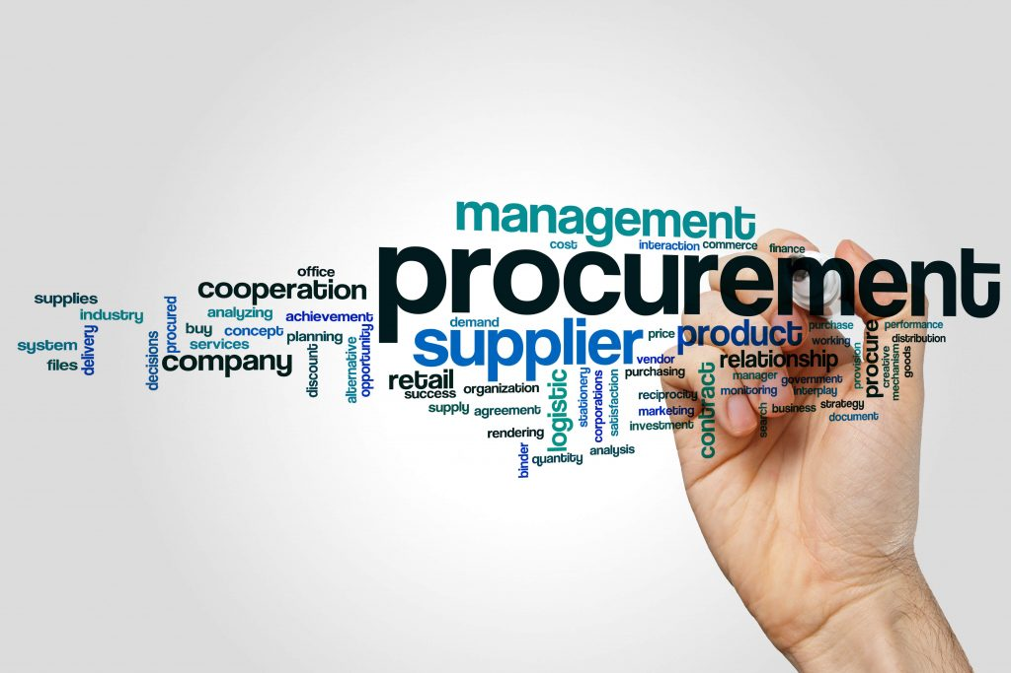

Target User
User 1
User 3
User 2
External Stakeholders
Vendors and Suppliers: Interface with the system for order management, invoicing, and supply chain coordination.
Customers and Clients: Access portals for order tracking, support requests, and account management (if the system includes customer-facing features).
Executives and Senior Management
CEOs, CFOs, COOs, and other C-level Executives
Department Heads and Directors
Team Leaders and Supervisors
Team Leads and Supervisors: Manage team schedules, task assignments, performance tracking, and team communication.
Product Managers: Coordinate product development, track progress, manage releases, and handle product lifecycle management.

Slide 7




Competitive Analysis
Selecting the right enterprise business management system depends on the specific needs and priorities of the business. Factors such as the size of the organization, industry requirements, budget constraints, and strategic goals play a critical role in this decision-making process. Conducting a thorough competitive analysis, as outlined above, helps in making an informed choice that aligns with the company’s long-term objectives.
Key Features and Functionality
Core Modules: Financial management, supply chain management, human capital management, customer relationship management, project management, etc.
Customization and Flexibility: Ability to tailor the system to specific business needs.
Integration: Compatibility with other software and platforms.
Scalability: Capability to grow with the business.
Cloud vs. On-premises: Deployment options available
Security and Compliance
Evaluate the security features:
Data Security: Encryption, data backup, and recovery options.
Compliance: Adherence to industry standards and regulations (e.g., GDPR, HIPAA).
Technology and Innovation
Evaluate the technological aspects:
Artificial Intelligence and Machine Learning: Use of AI/ML for predictive analytics and process automation.
Mobile Access: Mobile-friendly interfaces and apps.
Data Analytics and Reporting: Advanced reporting and real-time data analytics capabilities.
Customer Reviews and Case Studies
Analyze feedback from current users:
Customer Satisfaction: Ratings and reviews from businesses using these systems.
Case Studies: Success stories and practical applications in various industries.a

Slide 8
Financial Assessment
Cost of creating prototype
The cost of creating a prototype for your blockchain transparency project can vary significantly depending on various factors such as the complexity of the system, features included, technology stack, development team's experience, and the development approach chosen. However, I can provide you with a general breakdown of the typical costs involved:
Let's break down the potential costs involved:
Development Team: The cost of hiring developers, designers, and project managers will likely be the most significant portion of your budget.
Blockchain Developers: Rates for blockchain developers can vary widely depending on experience and location, but they typically range from $50 to $200 per hour. For a prototype project, you might need a small team of developers working for several weeks to a few months.
UI/UX Designers: Designers may charge between $40 to $150 per hour. The amount of time required will depend on the complexity of the user interface and user experience design.
Project Manager: Depending on the scope and duration of the project, you might need a project manager to oversee the development process. Project managers' rates can range from $50 to $150 per hour.
Infrastructure and Tools:
Blockchain Infrastructure: Costs associated with deploying smart contracts, storing data on the blockchain, and executing transactions can vary based on the blockchain platform chosen. You might need to budget for expenses related to gas fees (if using Ethereum or similar networks) or subscription fees for blockchain infrastructure services.
Development Tools: Costs for development tools, software licenses, and cloud services needed for coding, testing, and deployment. This might include tools for code versioning, testing frameworks, and hosting services.

Slide 9
Third-Party Services:
APIs and Integrations: If you're integrating with external systems or using third-party services for specific functionalities (e.g., identity verification, data analytics), there may be associated costs.
Legal and Compliance:
Legal Consultation: Consultation fees for ensuring compliance with relevant regulations, drafting user agreements, and protecting intellectual property rights.
Miscellaneous Expenses:
Marketing and Promotion: Budgeting for marketing activities to promote your prototype and gather feedback from potential users.
Contingency: It's wise to allocate a portion of your budget for unexpected expenses or scope changes during the development process.
Total Cost Estimate:
To provide a rough estimate, let's assume the following:
Development team consisting of 2 blockchain developers, 1 UI/UX designer, and 1 project manager.
Hourly rates: Blockchain developers ($100/hour), UI/UX designer ($70/hour), Project manager ($80/hour).
Development timeline: 3 months (assuming 40 hours per week).
Additional costs for infrastructure, tools, third-party services, legal consultation, marketing, and contingency.
Based on these assumptions, the total cost for creating a prototype for your project could range from $50,000 to $200,000 or more. However, please note that this is a rough estimate, and actual costs may vary based on your specific requirements and circumstances. It's advisable to consult with development firms or freelancers to get more accurate cost estimates based on your project's details.

Slide 10
Revenue Model
The revenue model for your blockchain transparency project can be structured in various ways to generate income while providing value to your users. Here are several revenue models you can consider:
Subscription Model:
Offer subscription-based pricing plans for organizations to access the blockchain transparency platform. Depending on the features and level of service included, you can offer different tiers of subscription plans with varying pricing levels. This model provides recurring revenue and encourages long-term customer relationships.
Transaction Fees:
Charge transaction fees for executing smart contracts or accessing data stored on the blockchain platform. The fees can be based on the complexity or volume of transactions processed through the platform. This model is suitable for platforms that facilitate frequent transactions or interactions between users.
Licensing Fees:
License your blockchain transparency platform to organizations or enterprises for a one-time fee or recurring royalties. This model allows you to monetize your technology while granting organizations the right to use your platform within their internal systems or processes.
Consulting Services:
Provide consulting services to help organizations integrate blockchain transparency solutions into their existing processes and systems. Offer customization, implementation, and ongoing support services tailored to the specific needs of each organization. Consulting services can be billed on a project basis, hourly rate, or retainer fee.
Data Analytics and Insights:
Monetize data analytics and insights derived from the transparent data stored on the blockchain platform. Offer analytics dashboards, reports, or predictive modeling services to help organizations make data-driven decisions and improve performance. You can charge subscription fees for access to advanced analytics features or sell individual reports and insights as add-on services.

Slide 11
Training and Certification:
Develop and offer training programs or certification courses related to blockchain technology, transparency, and data governance. Charge fees for training sessions, workshops, or certification exams to generate revenue and establish credibility in the market. This model can attract both individual learners and organizations seeking to upskill their workforce.
Partnerships and Integrations:
Form partnerships with other technology providers, industry associations, or regulatory bodies to expand the reach and capabilities of the blockchain transparency platform. Generate revenue through revenue-sharing agreements, referral fees, or integration fees for third-party services or platforms that integrate with your solution.
Custom Development and Integration:
Offer custom development and integration services to organizations with unique requirements or specific use cases. This model allows you to tailor your platform to meet the specific needs of each client and charge fees based on the scope and complexity of the project.
Freemium Model:
Offer a basic version of your blockchain transparency platform for free to attract users and demonstrate the value of your solution. Then, upsell premium features, advanced functionality, or additional support services to users who require more capabilities. This model allows you to acquire a large user base while monetizing premium offerings.
Advertisement and Sponsorship:
Monetize your platform through advertisements or sponsorships from relevant industry partners or organizations. You can display targeted advertisements within the platform or offer sponsorship opportunities for events, webinars, or other promotional activities.
Choose one or a combination of these revenue models based on your target market, competitive landscape, and the unique value proposition of your blockchain transparency project. Additionally, consider experimenting with different pricing strategies and revenue streams to optimize revenue generation and maximize the value delivered to your users.

Slide 12

Future Roadmap
Prototype
Launch
V2.0
V2.2
October 2024
May. 2026
Feb. 2027
Jun. 2027

Slide 13
Thank You

